Slide 1
Mall Customer Segmentation
TEAM MEMEBERS:
1. Shruthi Nanditha P
2. Shiny Aloysia A
3.Pooja Tanaji Mali 4.Syeda Sherin S 5.Monika s
6.Varsha G

Slide 2
1. Introduction

Slide 3
1.1 Problem Statement
Customer Segmentation is a popular application of unsupervised learning. Using clustering, identify segments of customers to target the potential user base. They divide customers into groups according to common characteristics like gender, age, interests, and spending habits so they can market to each group effectively.
Use K-means clustering and also visualize the gender and age distributions. Then analyze their annual incomes and spending scores.

Slide 4
1.2 Introduction to Problem Statement
To make predictions and ﬁnd the clusters of potential customers of the mall and thus ﬁnd appropriate measures to increase the revenue of the mall is one of the prevailing applications of unsupervised learning.
For example, a group of customers have high income but their spending score (amount spent in the mall) is low so from the analysis we can convert such type of customers into potential customers (whose spending score is high) by using strategies like better advertising, accepting feedback and improving the quality of products.
To identify such customers, this project analyses and forms clusters based on different criteria which are
discussed in the further sections.

Slide 5
2. Dataset

Slide 6
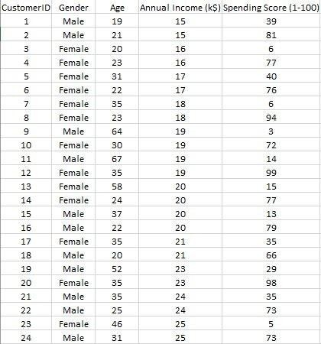
Overview of Dataset
The dataset name is Mall_Customers.csv consists of 5 columns which are CustomerID, Gender, Age, Annual Income (k$), Spending Score (1-100) where Gender is a categorical value and rest all features are numeric.
The size of the dataset is (200, 5) which is 200 rows and 5 columns.

Slide 7
3. Proposed Method & Architecture

Slide 8
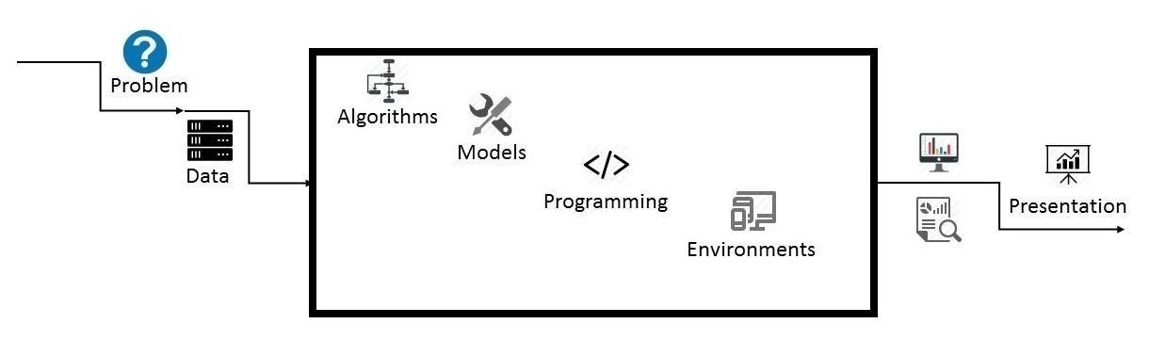
3.1 Architecture Overview
3.1 Data Science Project Architecture

Slide 9
3.2 Project Architecture
Data: The size of the dataset is (200, 5) which is 200 rows and 5 columns. Also on dataset does not contain any NULL or NaN values.
Algorithms: K-means algorithm is used in this project to analyze and form clusters of customers based on
their income and spending score features.
Model: K-means model is used and is hyper tuned parameters like n_clusters=5 using elbow method to ﬁnd the optimal number of clusters also init=’k-means++’ to avoid random initialization trap.
Programming Language: Python 3.6
Environment (Libraries and Technologies): Numpy, Pandas, Matplotlib, Seaborn, Jupyter Notebook, Google Colab.

Slide 10
4. Methodology

Slide 11
Methodology
Creating an approach to solve the given problem statement
Exploring the dataset and obtaining useful insight from the same
Cleaning the dataset by handling nan values, remove duplicate records, etc.
Data Visualization used to obtain important information from the data
Data Preprocessing is performed to make the data ready to ﬁt the model this includes feature
scaling, splitting the dataset into features and labels, etc.
Model Building

Slide 12
5. Implementation and Analysis

Slide 13
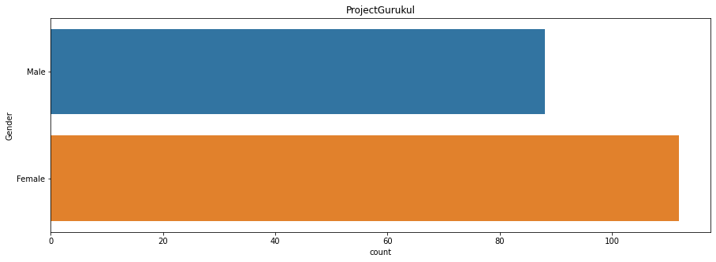
5.1 Gender Plot
Gender Plot Analysis:
From the Count plot, it is observed that
the number of Female customers is more than the total number of Male customers.

Slide 14
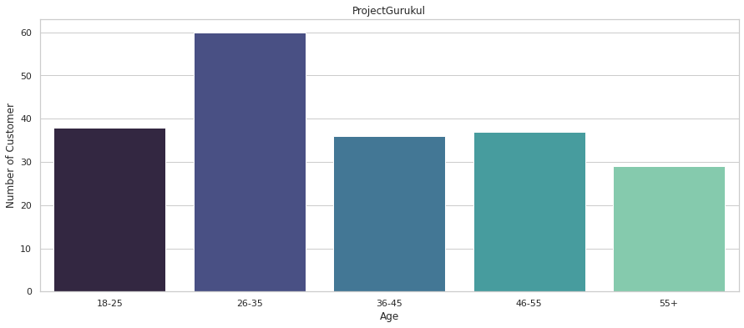
5.2 Age Plot
Age Plot Analysis:
Using BarPlot, we have grouped the customers into five groups in which it is evident that more number of customers are present at the age group of 26-35.

Slide 15
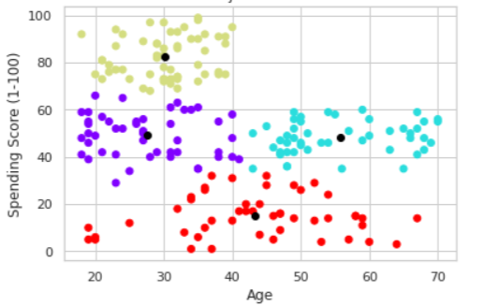
5.3 Age Vs Spending Score
Age Vs Spending Score Analysis
From the Age Vs Spending Score plot we observe that customers whose spending score is more than 65 have their Age in the range of 15-40 years.
The customers having average spending score ie: in the range of 40-60 consists of the age group of the range 15-75 years.

Slide 16
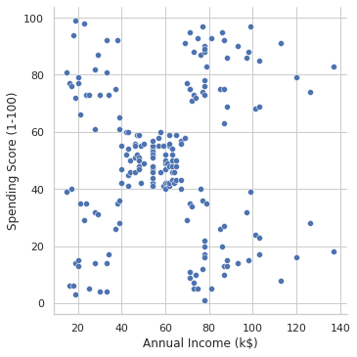
5.4 Annual Income Vs Spending Score
Annual Income Vs Spending Score Analysis
We observe that there are 5 clusters and can be categorized as:
High Income, High Spending Score (Top Right Cluster)
High Income, Low Spending Score
(Bottom Right Cluster)
Average Income, Average Spending Score
(Center Cluster)
Low Income, High Spending Score (Top
Left Cluster)
Low Income, Low Spending Score
(Bottom Left Cluster)

Slide 17
6. Conclusion

Slide 18
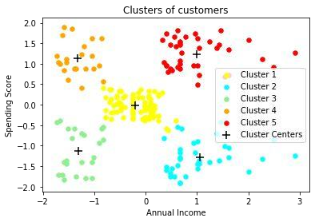
Clustering Analysis
High Income, High Spending Score (Cluster 5) - Target these customers by sending new product alerts which would lead to an increase in the revenue collected by the mall as they are loyal customers.
High Income, Low Spending Score (Cluster 2) - Target these customers by asking the feedback and advertising the product in a better way to convert them into Cluster 5 customers.
Average Income, Average Spending Score (Cluster 1) - May or may not target these groups of customers based on the policy of the mall.
Low Income, High Spending Score (Cluster 4) - Can target these set of customers by providing them with Low-cost EMI's, etc.
Low Income, Low Spending Score (Cluster 3) - Don't target these customers since they have less income and need to save money.

Slide 19

Thankyou!

